Slide 1
Home Automation
Paul Schweng

Slide 2
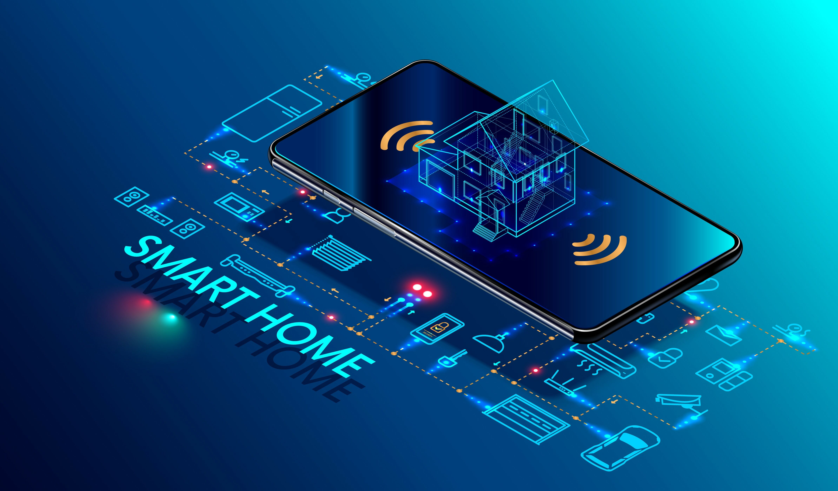
Agenda
Introduction
Overview
Setup

Slide 3

Introduction
We are going to learn how to use these Google Home Automation Tools:
Google Cloud (HomeGraph API)
Firebase (Firestore, Hosting, Cloud Functions)
Google Home / Assistant

Slide 4
Introduction
In the end you will be able to:
Host websites
Setup your own smart devices
Control them through your webapp or Google Assistant AI

Slide 5
Overview

Slide 6
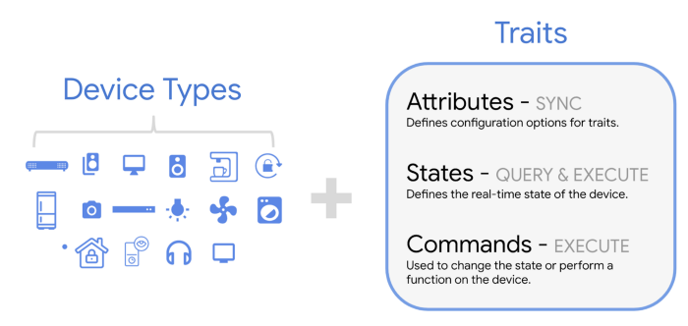
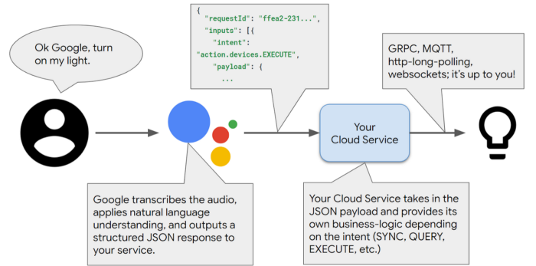
Structure
Intent
But what‘s hidden in the blue box?

Slide 7
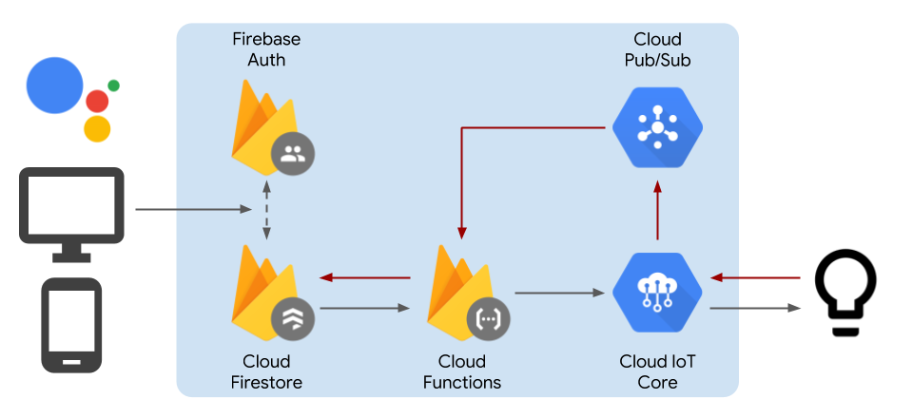
Structure

Slide 8
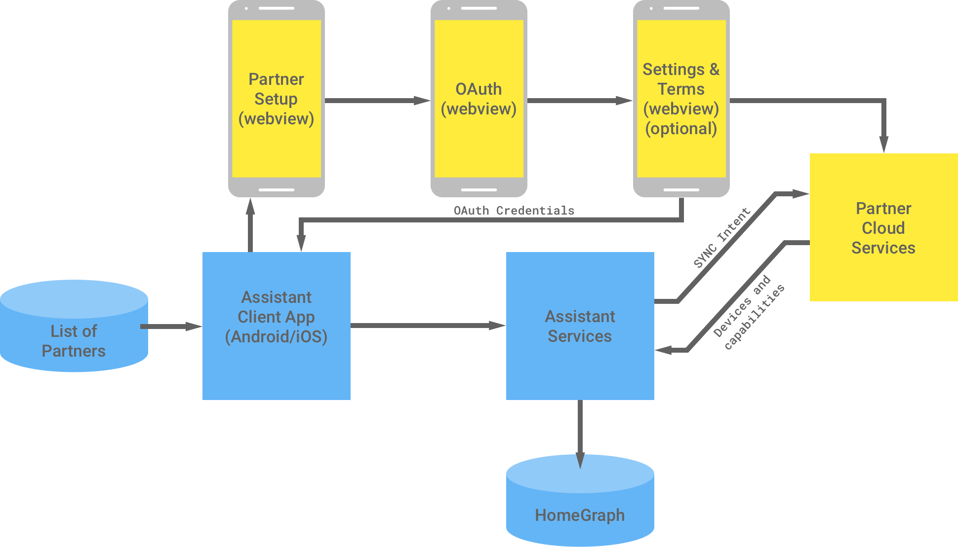
Structure (SYNC intent)
SYNC intent is sent once (on app register) and retrieves list of user devices.

Slide 9
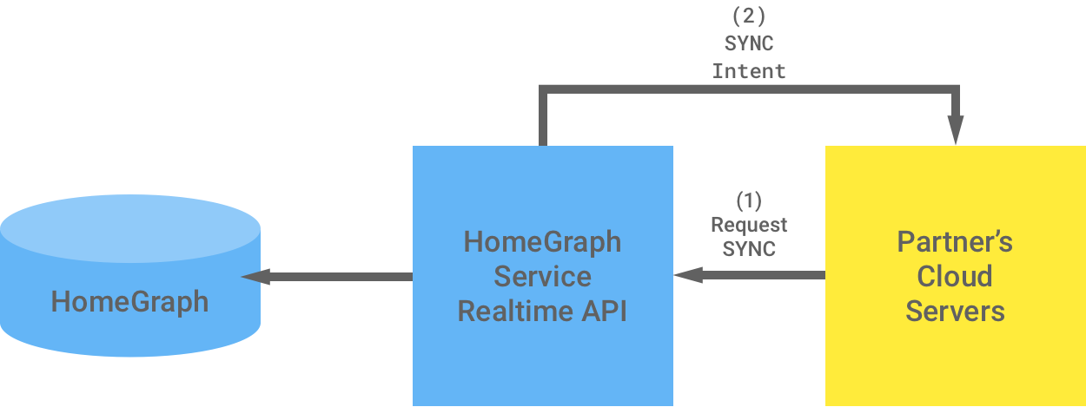
Structure (SYNC intent)
To overcome this limitation: Request a SYNC when modifying your devices.

Slide 10
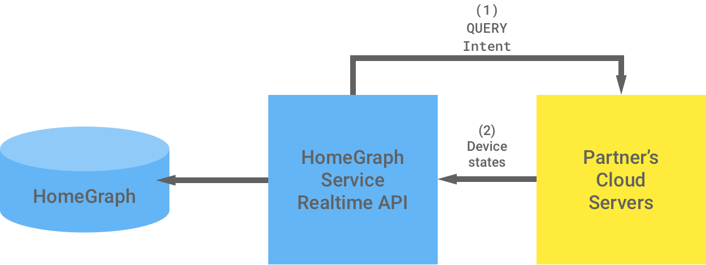
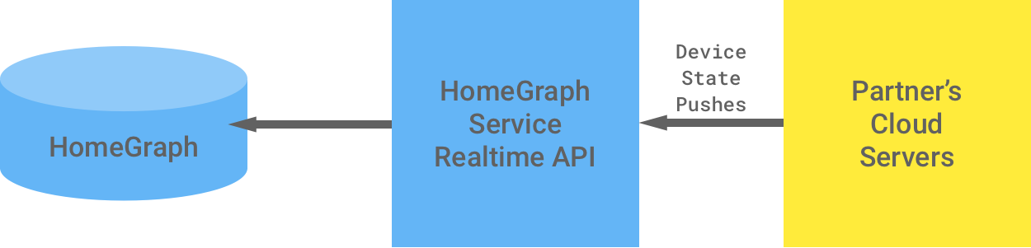
Structure (QUERY intent)
Request device states with a QUERY intent
Push device states proactively to HomeGraph

Slide 11
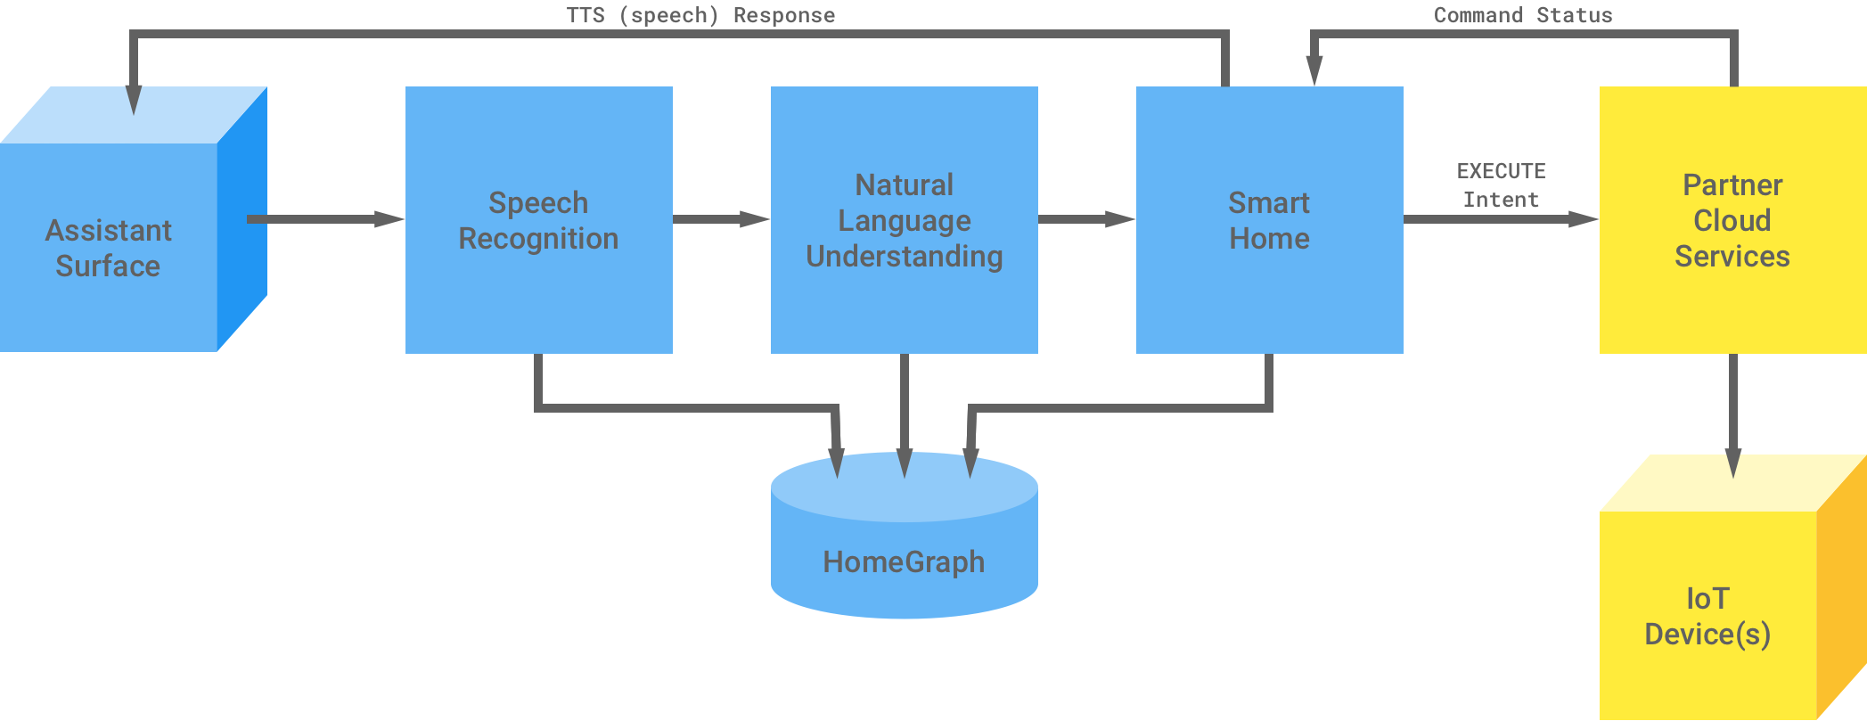
Structure (EXECUTE intent)
The HomeGraph API lets Google Assistant know the devices’ traits and where they are located (e.g. living room). No need of sending a QUERY intent to your webapp.

Slide 12
Setup
Using Google‘s smart home end-to-end sample

Slide 13
Setup
Requirements
Nodejs (v12.13.0)
Linux Shell (run every command from there)
Clone this project
Create a Google action
git clone https://github.com/paul-schweng/eportfolio-HomeAutomation
cd eportfolio-HomeAutomation

Slide 14
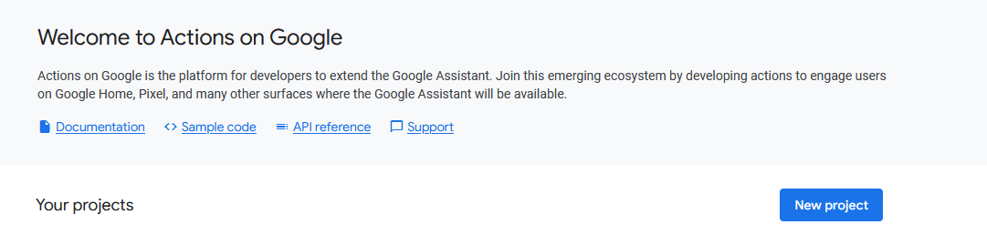
Creating a Google Action

Slide 15
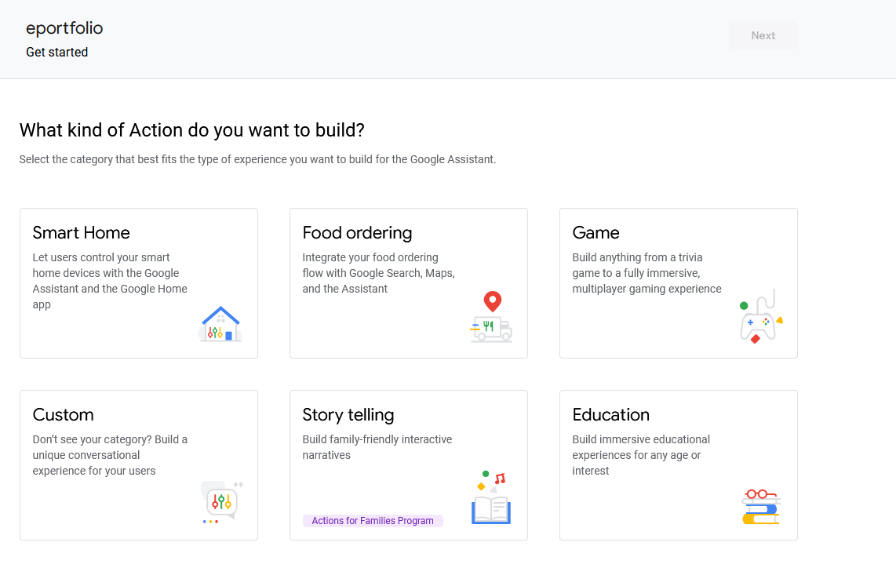
Creating a Google Action

Slide 16
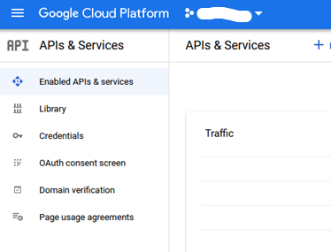
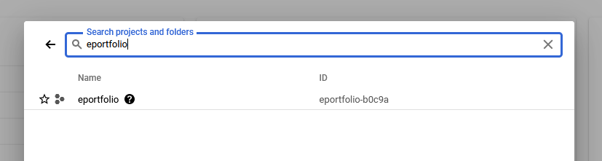
Add Request Sync and Report State
Link your action to Google Cloud

Slide 17
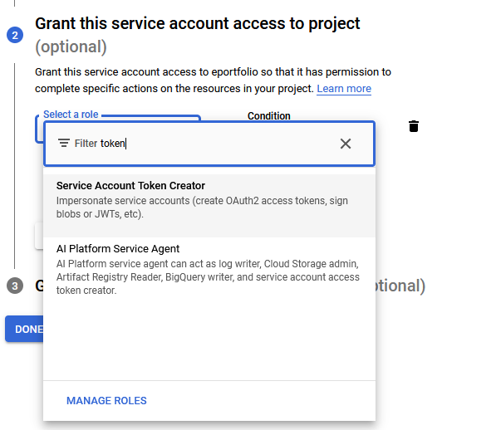
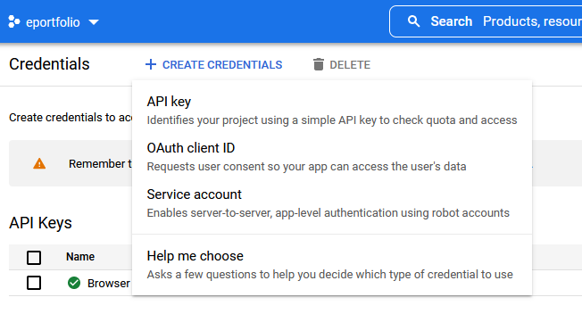
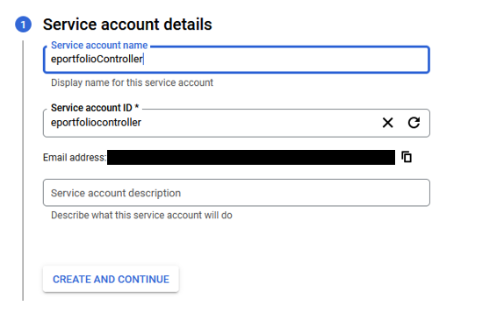
Add Request Sync and Report State
Search for HomeGraph API and enable it
Navigate to the Google Cloud Console API & Services page

Slide 18
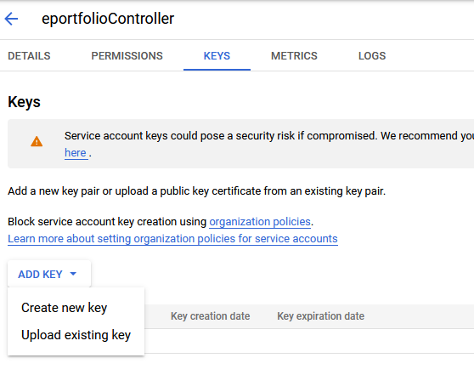
Add Request Sync and Report State
Download the JWT of your service account and save it in `src/smart-home-key.json`

Slide 19
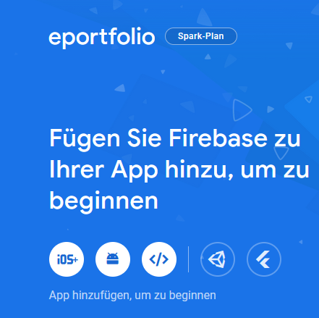
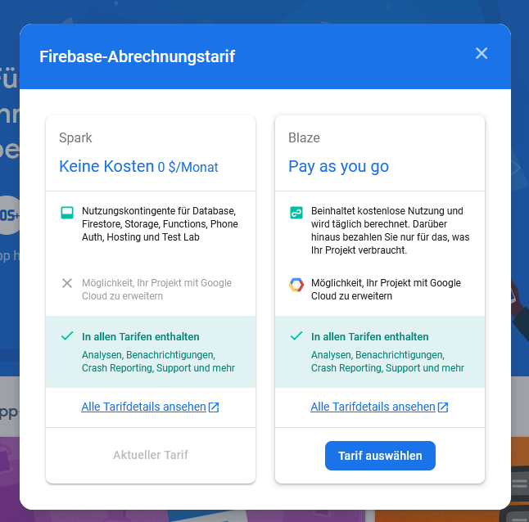
Configure Cloud Firestore
Open your Firebase Console and select your project
Change your billing plan to Blaze

Slide 20
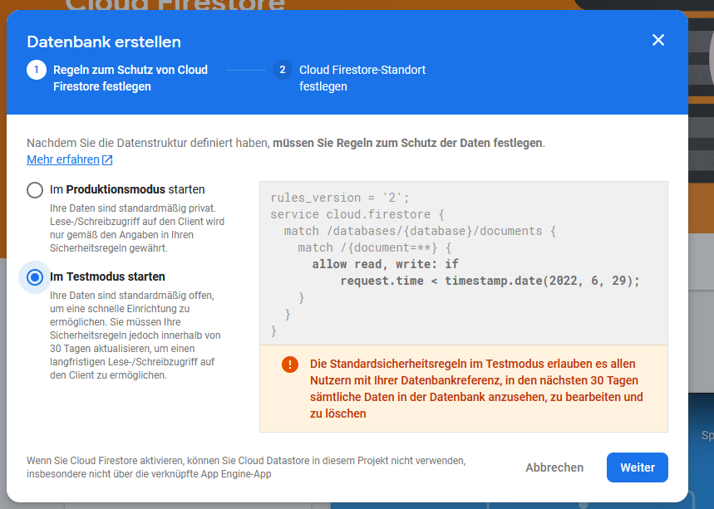
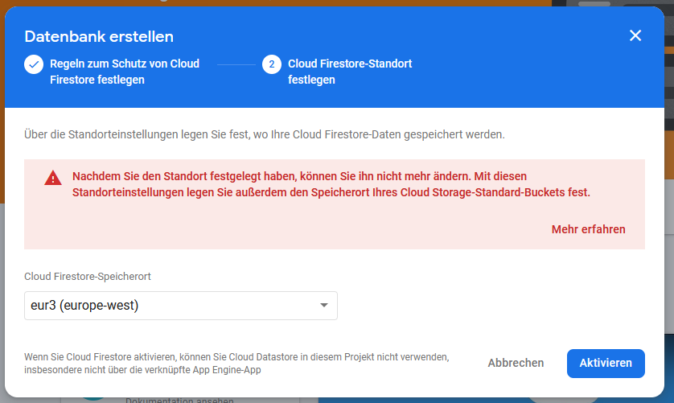
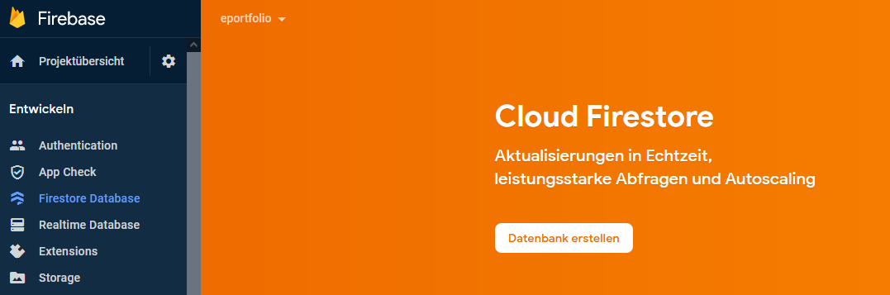
Configure Cloud Firestore
Create a Firestore Database

Slide 21
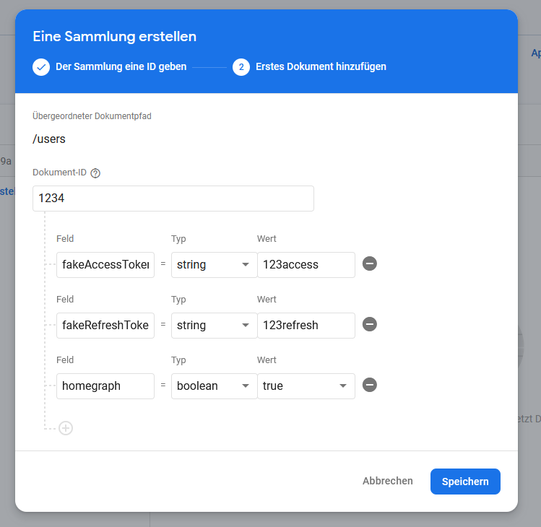
Configure Cloud Firestore
Create an initial collection
users\
1234
fakeAccessToken: "123access“
fakeRefreshToken: "123refresh“
homegraph: true

Slide 22
Deploy to Firebase Cloud Functions and Hosting
Run these commands:
If you encounter errors with Firebase CLI:
Is Firebase installed? (run npm install -g firebase-tools)
Are you logged in? (run firebase login)
Is your project selected? (run firebase use –add)
npm install
npm --prefix frontend install
npm run deploy

Slide 23
Deploy to Firebase Cloud Functions and Hosting
If you encounter errors on deploy:
Are you logged in? (run firebase login)
Is your project selected? (run firebase use –add)

Slide 24
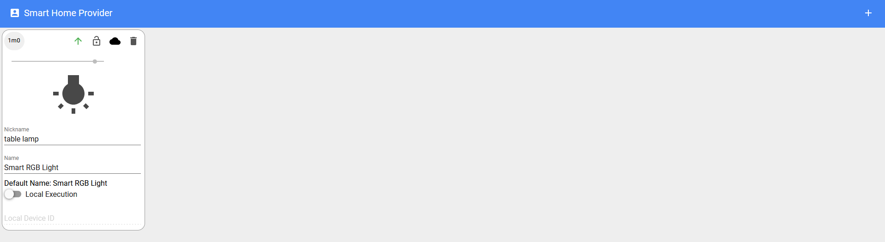
Deploy to Firebase Cloud Functions and Hosting
If deployment was successful, you can visit your webapp here: https://<PROJECT-ID>.web.app
The webapp should look something like this after you added your first device:

Slide 25
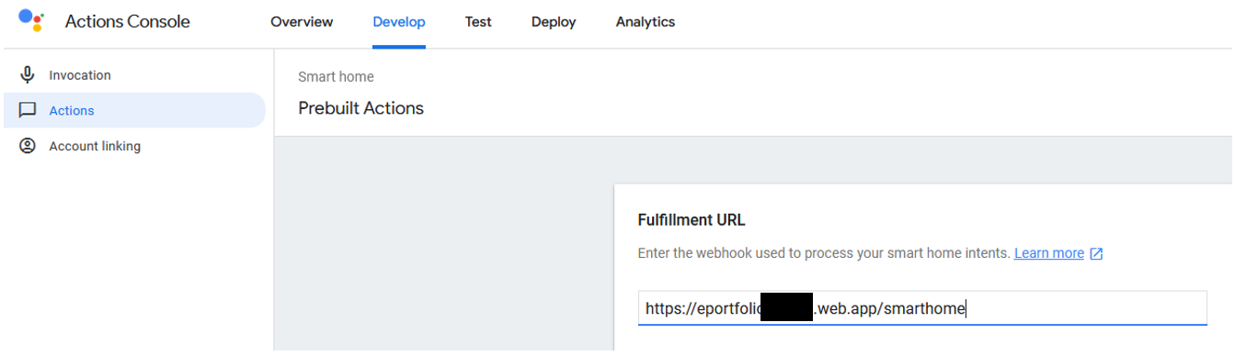
Configure your Google Action
Navigate back to the Google Actions Console
Enter the fulfillment URL

Slide 26
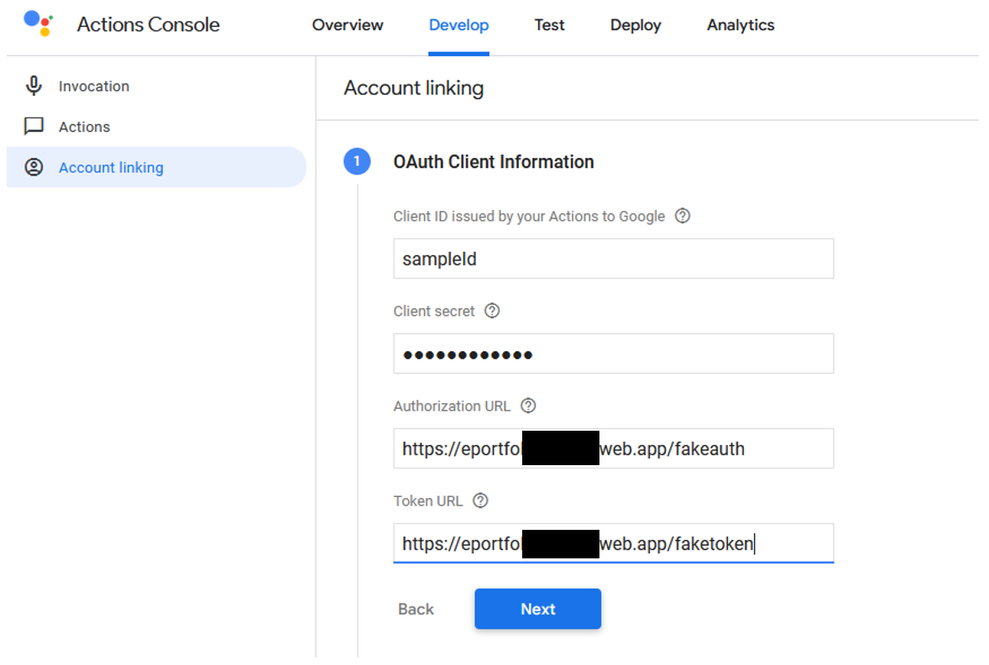
Configure your Google Action
Enter Oauth Client Information:
Client ID: sampleId
Client secret: sampleSecret
Enter shown URLs

Slide 27
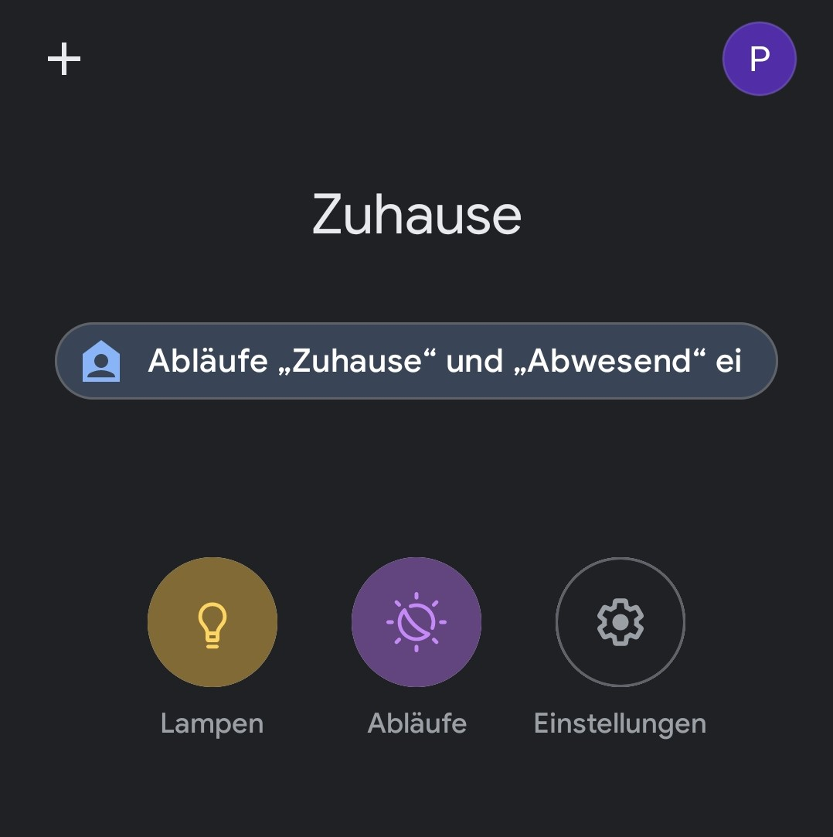
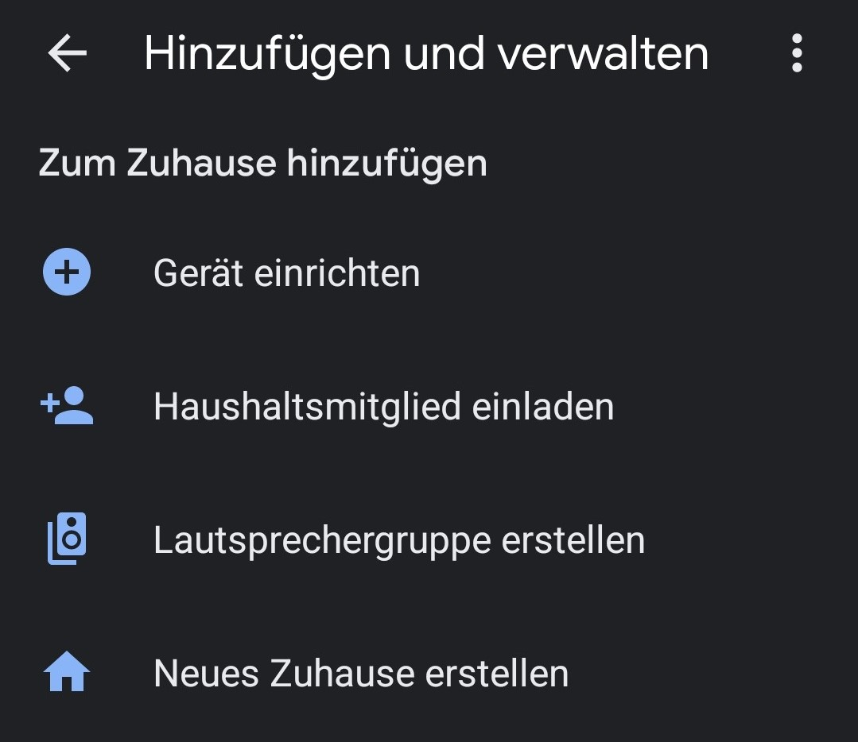
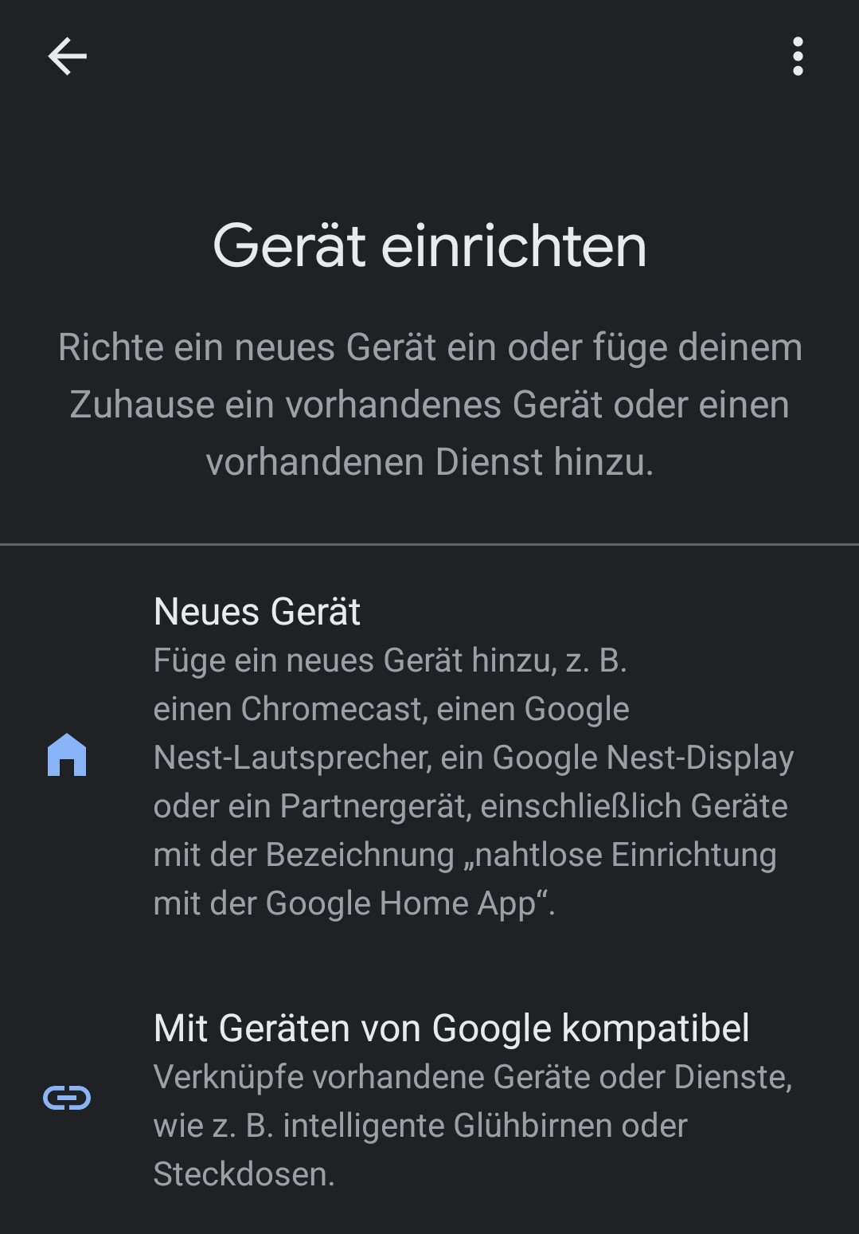
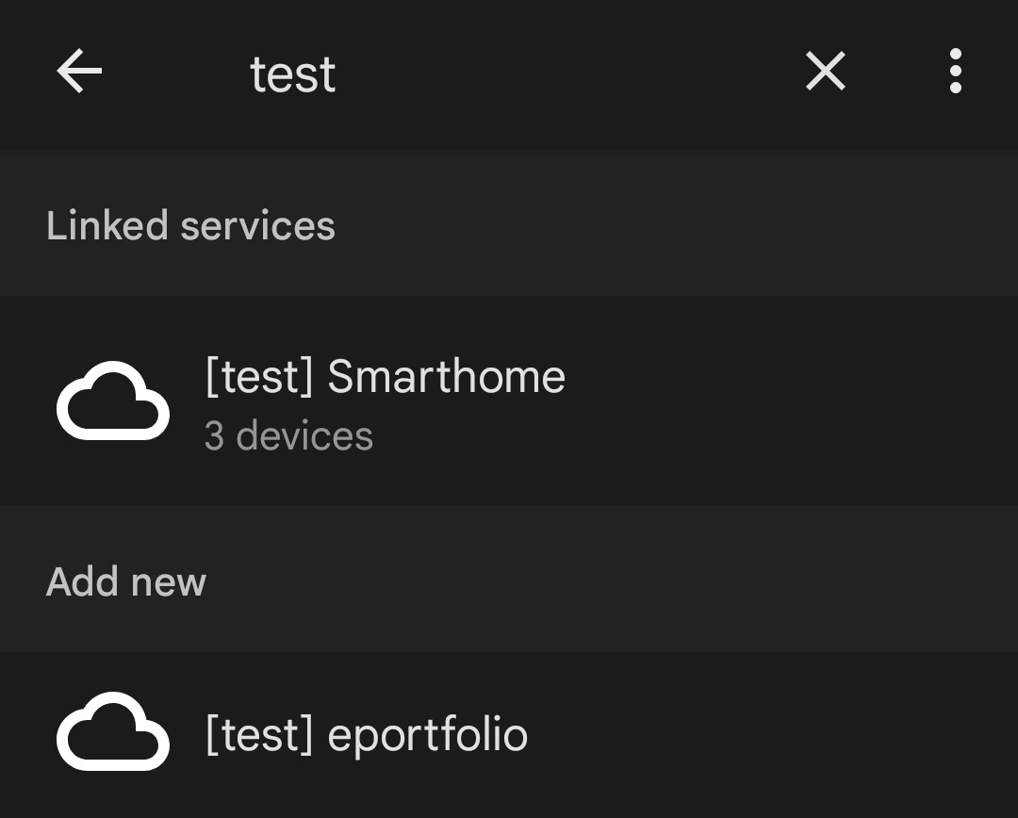
Connect Google Assistant
On your phone: Download Google Home from the playstore
Inside the app:

Slide 28
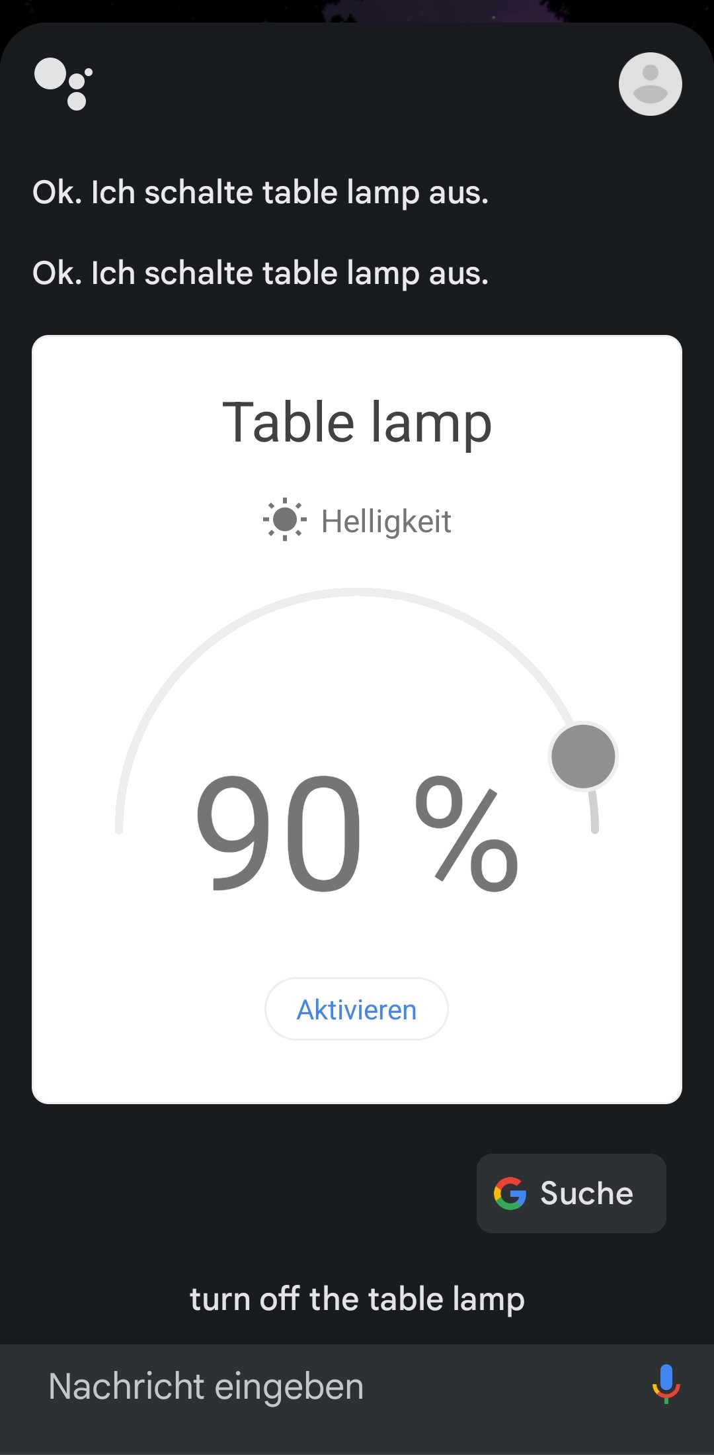
Connect Google Assistant
Hey Google, turn off the table lamp
After adding the Google Action:
Interact with your devices in Google Home / through Google Assistant

Slide 29
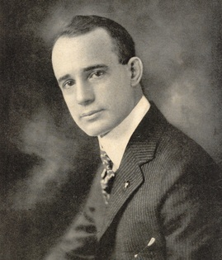
It takes half your life before you discover life is a do-it-yourself project.
Napoleon Hill

Slide 30



Zusammenfassung
Mit PowerPoint können Sie Präsentationen erstellen und Ihre Arbeit mit anderen teilen, wo immer sie sich befinden. Geben Sie hier den gewünschten Text ein, um loszulegen. Sie können dieser Vorlage auch Bilder, Grafiken und Videos hinzufügen. Speichern Sie in OneDrive, und greifen Sie von Ihrem Computer, Tablet oder Telefon auf Ihre Präsentationen zu.

Slide 31




Thank you!
Paul Schweng

